Slide 1

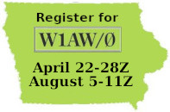
ARRL America250 Worked All States W1AW Portable in Iowa
What is it?
A Year-Long Worked-All-States Operating Event Celebrating the 250th Anniversary
(Semiquincentennial) of the signing of the U.S. Declaration of Independence.
Why is it called portable? That’s because it is not at the Newington, CT W1AW shack.
Iowa's participation as W1AW/Ø runs April 22-28 and August 5-11, UTC.
Each participating ham gets as many 2 hour operating slots as desired, subject to
It not being already claimed. Each slot is one band and one mode.
The modes are CW, digital and phone.
The bands are 2200 Meters LF through all of HF; all of VHF/UHF/SHF, all of the
Microwave bands and Light (excluding 60 Meters).

Slide 2
ARRL America250 Worked All States W1AW Portable in Iowa
How do I participate??
Sign up at Ham-QTV.com
You will receive a packet once approved. REMEMBER YOUR PASSWORD!!
Log in at Ham-QTV and select the 2-hour operating times and modes you want.
When your selected day(s) and time(s) come up, be sure to use UTC (Z)!
Start operating, signing as W1AW/Ø and logging to a program that can export your log to an ADIF file.
When you are done for the week, submit your log as directed in the Operator Guideline.
Sit back and bask in the glow of knowing you helped others earn their WAS award!
ELECTRONIC LOGGING MUST BE PERFORMED DURING THE COURSE OF THE OPERATING EVENT! NO PAPER LOGS WILL BE ACCEPTED!

Slide 3
ARRL America250 Worked All States W1AW Portable in Iowa
MAKE PERIODIC BACKUPS OF THE LOGGING FILE THAT YOU HAVE IN USE.
Commonly used logging software such as N3FJP and N1MMLogger+ are recommended, but any software that will generate an ADIF‐formatted file is acceptable.
Ensure that each band/mode operating station is prepared to supply ALL station data in every QSO line (such as county, grid square, CQ/ITU zones, etc.)
Call as W1AW/0 on CW or digital, W1AW/portable zero on voice.
Choose your operating frequency according to the band plan, your license class privileges, and ask at least two times if it is in use before calling CQ [eg, complaints about being too close to another operation must be resolved by QSYing, not by arguing.]
Operators must avoid operating too close to license class or band edges as well.

Slide 4
ARRL America250 Worked All States
W1AW Portable in Iowa
Operators must operate using the privileges granted only by their personal license class serving as a control operator (or within the operator privileges of the highest‐class Control Operator present and observing operations – Eg, a Novice/Technician Class license holder, however, can operate on General Class or above bands provided a properly licensed Control Operator is present with them at all times.)
Calling “CQ WAS-250” is a great way to draw attention.
While the object of the WAS-250Worked All States event is to hand out as many contacts with W1AW/Portable States as possible, operators are encouraged to explain the celebrations of 2026 (Semiquincentennial ARRL WAS-250 Worked All States Award {together with the Year of The Club and 100th Anniversary of the Field Organization} to the degree that your operating time may allow.
Encourage other operators to get on the air, make contacts, and have fun.

Slide 5

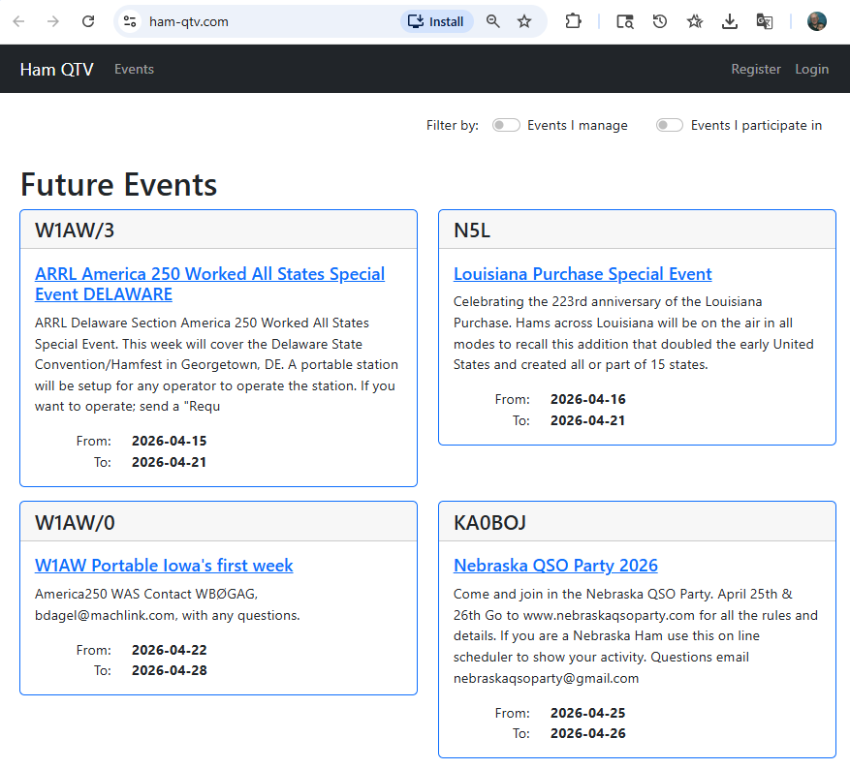
ARRL America250 Worked All States W1AW Portable in Iowa

Slide 6
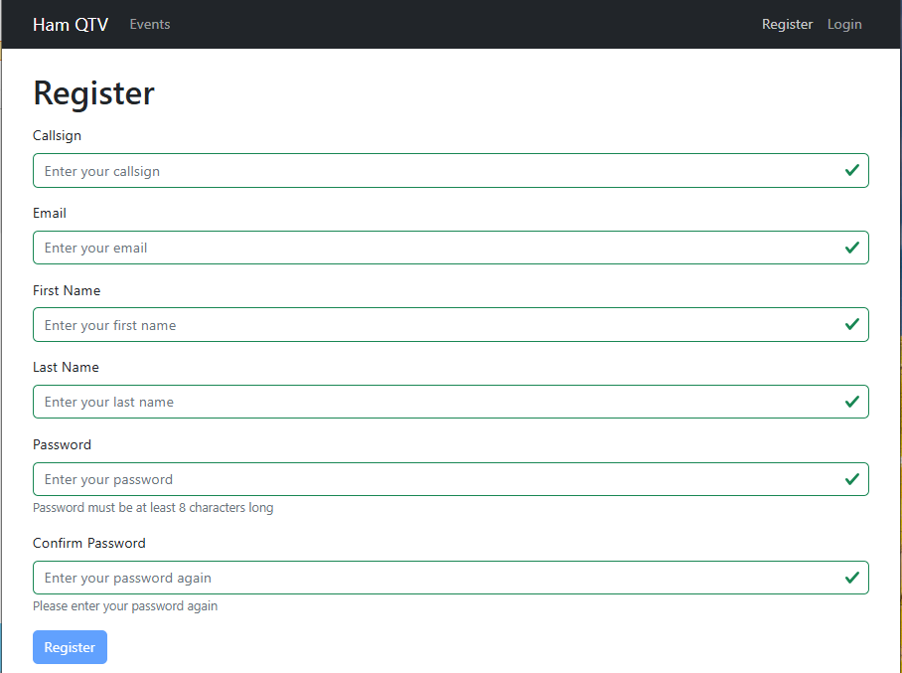
ARRL America250 Worked All States
W1AW Portable in Iowa

Slide 7
ARRL America250 Worked All States
W1AW Portable in Iowa
DO NOT LOSE TRACK OF YOUR PASSWORD!!
There is no recovery method.

